Slide 1


Open Source Open Mind
TW Xi’an

Slide 2
History
Unix
1970
1979~1984
OSS(OSI)
1998
GNU/Linux
1990
BSD(CSRF)
GNU(FSF)

Slide 3
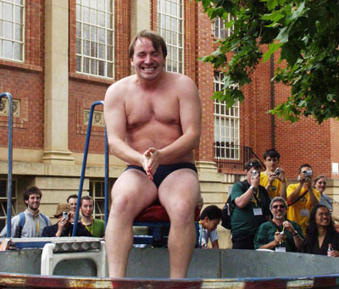


Slide 4
What is OSS
Free Redistribution
Availability of source code
Copyright license
No discrimination

Slide 5
3C of OSS
Code
Collaboration
Community

Slide 6
OSS License
Close-Source support
Non-Close-Source support

Slide 7
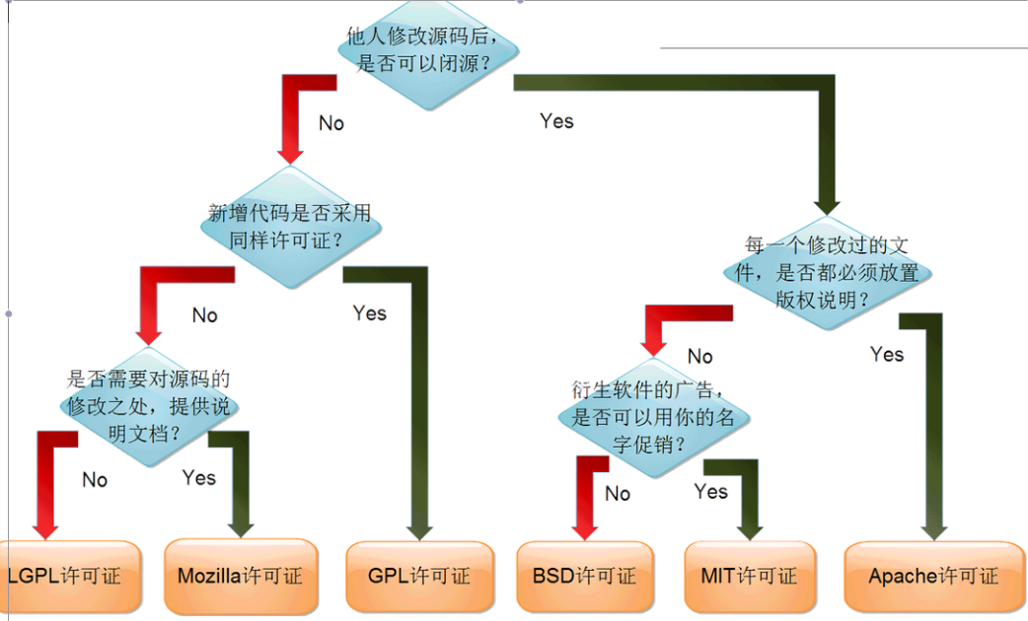
Open Source License

Slide 8
MySQL (GPL/MySQL AB)
JBOSS (LGPL)
Android (APL)
JQuery (MIT)
CruiseControl (BSD-style License)

Slide 9
OSS Hosting
Github
Gitorious
SourceForge
Google code project

Slide 10
Community
Wiki
Blogs
Maling lists
IRC channel

Slide 11
Tooling
Version Control
Building/Packaging
Bug Tracking

Slide 12
How to Profit

Slide 13
What we are committing
http://opensource.thoughtworks.com/

Slide 14
Just Do It

